Slide 1
MUSIC CLASSIFICATION
By Kritin Okhandiar

Slide 2
EXECUTIVE SUMMARY
This project aims to develop a system which can differentiate the song inputted into it classify them into their respective genre.
Tone A
Rock
Tone B
Jazz
Tone C
Hip Hop
Tone D
Classic

Slide 3
PROBLEM STATEMENT
Automatic genre detection while uploading
Search section for song (Proof of concept)
Tool for music composers

Slide 4
DATA SOURCE
GTZAN Dataset (Link)
A collection of 10 genres with 100 audio files each, all having a length of 30 seconds (the famous GTZAN dataset, the MNIST of sounds)
Contains 1000 audio files divided into 10 different genres
The genres are Blues, Classical, Country, Disco, Hip-hop, Jazz, Metal, Pop, Reggae, Rock

Slide 5
METHODOLOGY
Data Exploration
Check if all audio file is in wav format
Check meta data for signs of corruption
Library Versions
Data Augmentation
Training/Testing
Deployment

Slide 6
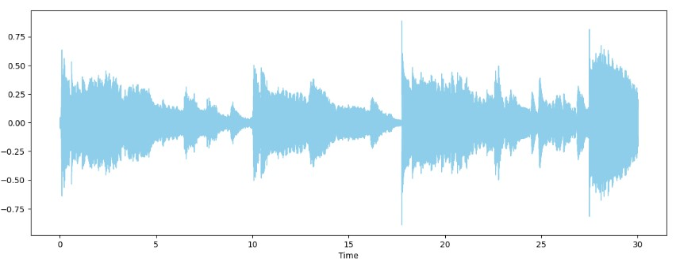
METHODOLOGY
VISUALIZATION:-
Sample Rate
Sample rate, also known as sampling frequency, is the number of samples taken per second from an analog audio source to create a digital file. Sample rate is measured in hertz (Hz) or samples per second (sps). The higher the sample rate, the more snapshots of the audio signal are captured, and the more accurate the digital file will be
Sample rate of training data is 22050
Fig: Jazz Visualization

Slide 7
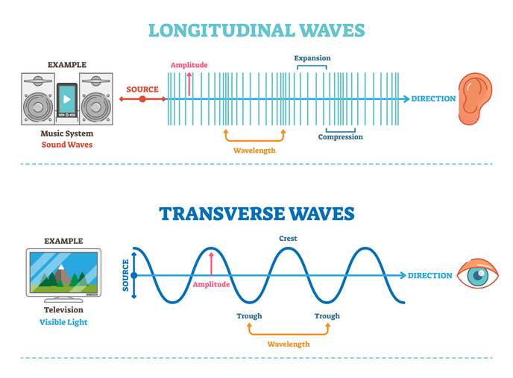
METHODOLOGY
VISUALIZATION:-
Why Librosa
We can do the same with wavfile from scipy library
Some audio file can have different sample rates
Librosa converts stereo into mono
Librosa normalises the audio
Fig: Sound Visualization

Slide 8
TOOLS
Jupyter
Windows Player
Tensorflow, Pandas, Numpy & Librosa.

Slide 9
RISKS AND CHALLENGES
Accuracy
The training data may not be sufficient
Overfitting
Data Size
The dataset is of 1GB and may lag the computer
Deployment
May not perform as indented and will need some revisions

Slide 10
THANK YOU
Kritin Okhandiar
+91 93258 98557
kritin.india@gmail.com
https://www.linkedin.com/in/kritin-okhandiar-bba99a157/

